Slide 1
Design Update #1
Joshua thao, Jonathan benusa, jack schumacher

Slide 2
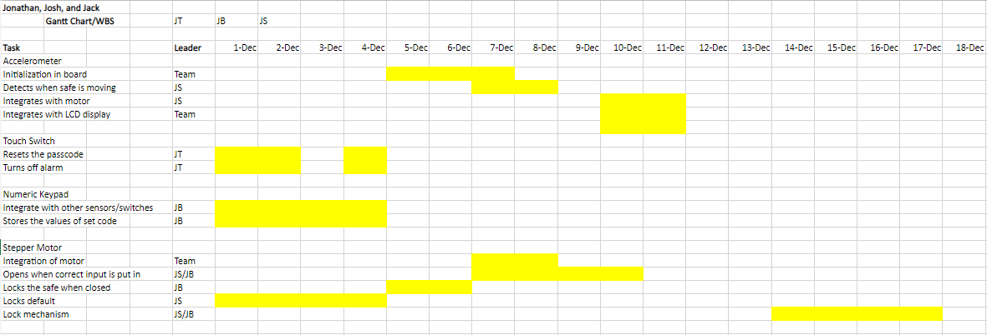
WBS/GANTT Chart for last/this week Part I

Slide 3
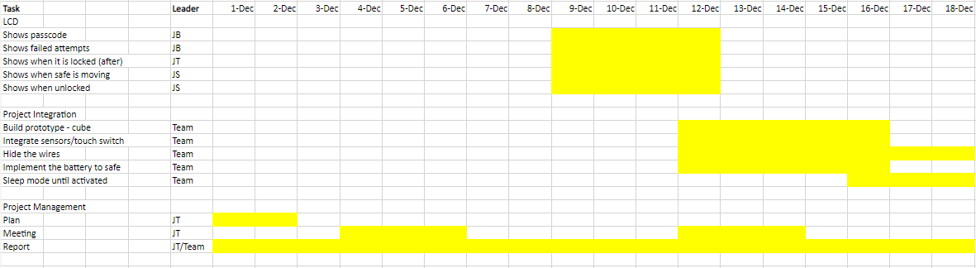
WBS/GANTT Chart for last/this week Part II

Slide 4
Outcomes
Stepper Motor Lock Mechanism:
Jack has created a skeleton code, which can be modified for other inputs/sensors
Numeric Keypad:
Jonathan has created a skeleton code, which can be modified for other inputs/sensors
Project Management:
Gantt Chart/WBS has been set and decided by Team

Slide 5
Shortcomings
Touch Button:
Not finished according to plan of WBS/Gantt Chart
Project Integration
Not enough discussion about alarm or security associated with the safe. (Can be discussed after programming for most of the sensors/input devices has been completed).

Slide 6
Plans Onward (This week)
Accelerometer:
Begin initializing as Team
Implement function in board (after initializing)
Touch Switch
Apply after numeric keypad has been implemented
Stepper Motor:
Integrate with Numeric Keypad
LCD:
Create display functions for LCD
Project Management:
Begin writing the report

Slide 7
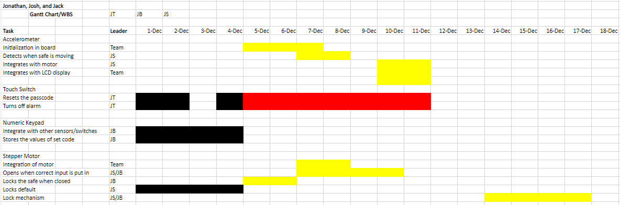
WBS/Gantt Chart (Plans Onward)

Slide 8
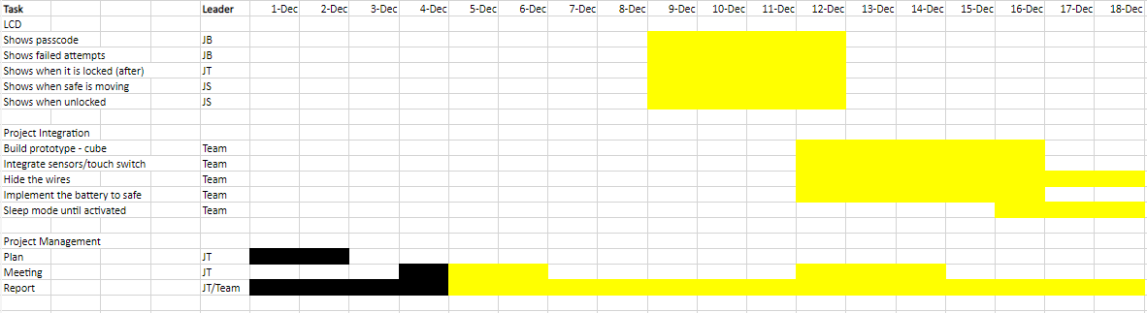
WBS/Gantt Chart (Plans Onward)

